Slide 1

Entertainment-Education as a
Change Agent for Gender Norms and Health Practices
Amy Henderson Riley
Doctoral Student
Drexel School of Public Health
Department of Community Health and Prevention March 13, 2014

Slide 2
What is entertainment-education?
“the process of designing and implementing a media message to both entertain and educate to increase audience members' knowledge about an educational issue, create favorable attitudes, and change overt behavior” – (Rogers & Singhal, 1999)
Notes:
Health comm strategy
Television, radio, theatre

Slide 3

What is Kyunki…Jeena?
Notes:
Long-running e-e
501 episodes
13 behavior objectives from UNICEF Facts for Life
“Because that’s what life is”
Primary audience women and their families

Slide 4

Gender and Women’s Health Objectives
Girls education
Domestic violence
Women in elected positions
Timing births
Breastfeeding
Births with a skilled
attendant
Notes:
WHAT ARE NORMS? – beliefs about the prevalence of behavior, what you think other people do
Health challenges in India

Slide 5

Results
It works!
But how?
Narrative structure – characters as role models
Role of social norms?
Notes:
Exposed vs unexposed
High levels of exposure, message, and story recall

Slide 6
Conceptual Model – Direct Effects
Exposure to Kyunki…
(Independent Variable)
Behavior change (Dependent variable)
Notes:
Original model – direct effects

Slide 7
Knowledge model - Indirect effects
Age, religion, geography
(Confounding Variables)
Exposure to Kyunki…
(Independent Variable)
Behavior change (Dependent variable)
Norms?
Knowledge, awareness
(Mediating Variables)
Notes:
Indirect effects

Slide 8
Future model – Norms?
Age, religion, geography
(Confounding Variables)
Exposure to Kyunki…
(Independent Variable)
Behavior change (Dependent variable)
Knowledge, awareness
(Mediating Variables)
Norms?

Slide 9
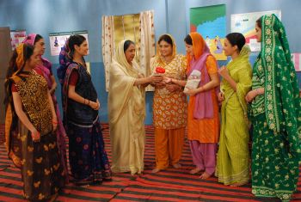
Norms and Kyunki
Measurement tools?
Implications for future entertainment-education
Notes:
How to measure norms?
Do you need norms to change behaviors or behaviors to change norms?

Slide 10


References and Acknowledgments
Rogers, E., & Singhal, A. (1999). Entertainment-education: A Community Strategy for Social Change. Mahwah, NJ:Erlbaum.
Sood, S., Mazumdar, P.D., Chowdary, N., Riley, A.H., & Malhotra, A. (2013). From awareness- generation to changing norms: Implications for entertainment-education. [Manuscript submitted for publication.]

